Slide 1
Canadian Bioinformatics Workshops
www.bioinformatics.ca

Slide 2



GitHub: Not Just a Code Repository
Ann Meyer
Open Science Platforms for Bioinformatics Education
July 22, 2017

Slide 3
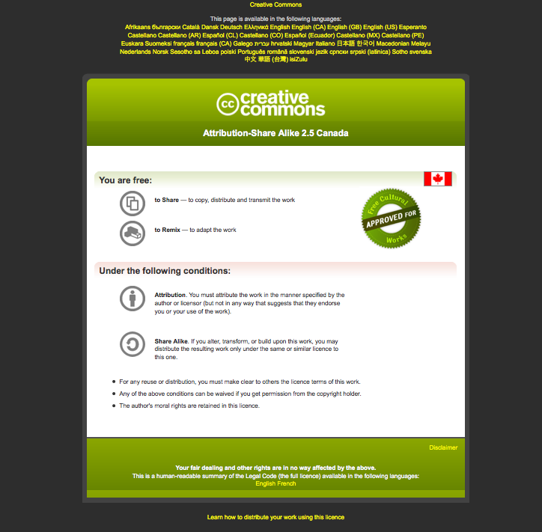
Module #: Title of Module
3

Slide 4
The Context: bioinformatics.ca
Notes:
Started in 1999 offering 1- to 2-week workshops in bioinformatics. Started offering shorter 1- to 5-day workshops in 2008. This year offered 12 workshops. Small class sizes (max 30 students)

Slide 5

Need a mechanism that allows:
Content to be created by multiple individuals
Sharing of small and large datasets
Easy downloading of all the materials
Reversion back to a working version
And also is:
Intuitive for students and content creators to use
Free

Slide 6

In GitHub:
Instructors are assigned to teams
Small files can be added directly to repos; large files added through LFS ($)
Individual repos can be forked or downloaded directly
Version control to revert back to previous commits
And also:
Instructors use GitHub markdown to create content
Content is rendered as a fully customizable website
Free!!!

Slide 7
The Set Up

Slide 8
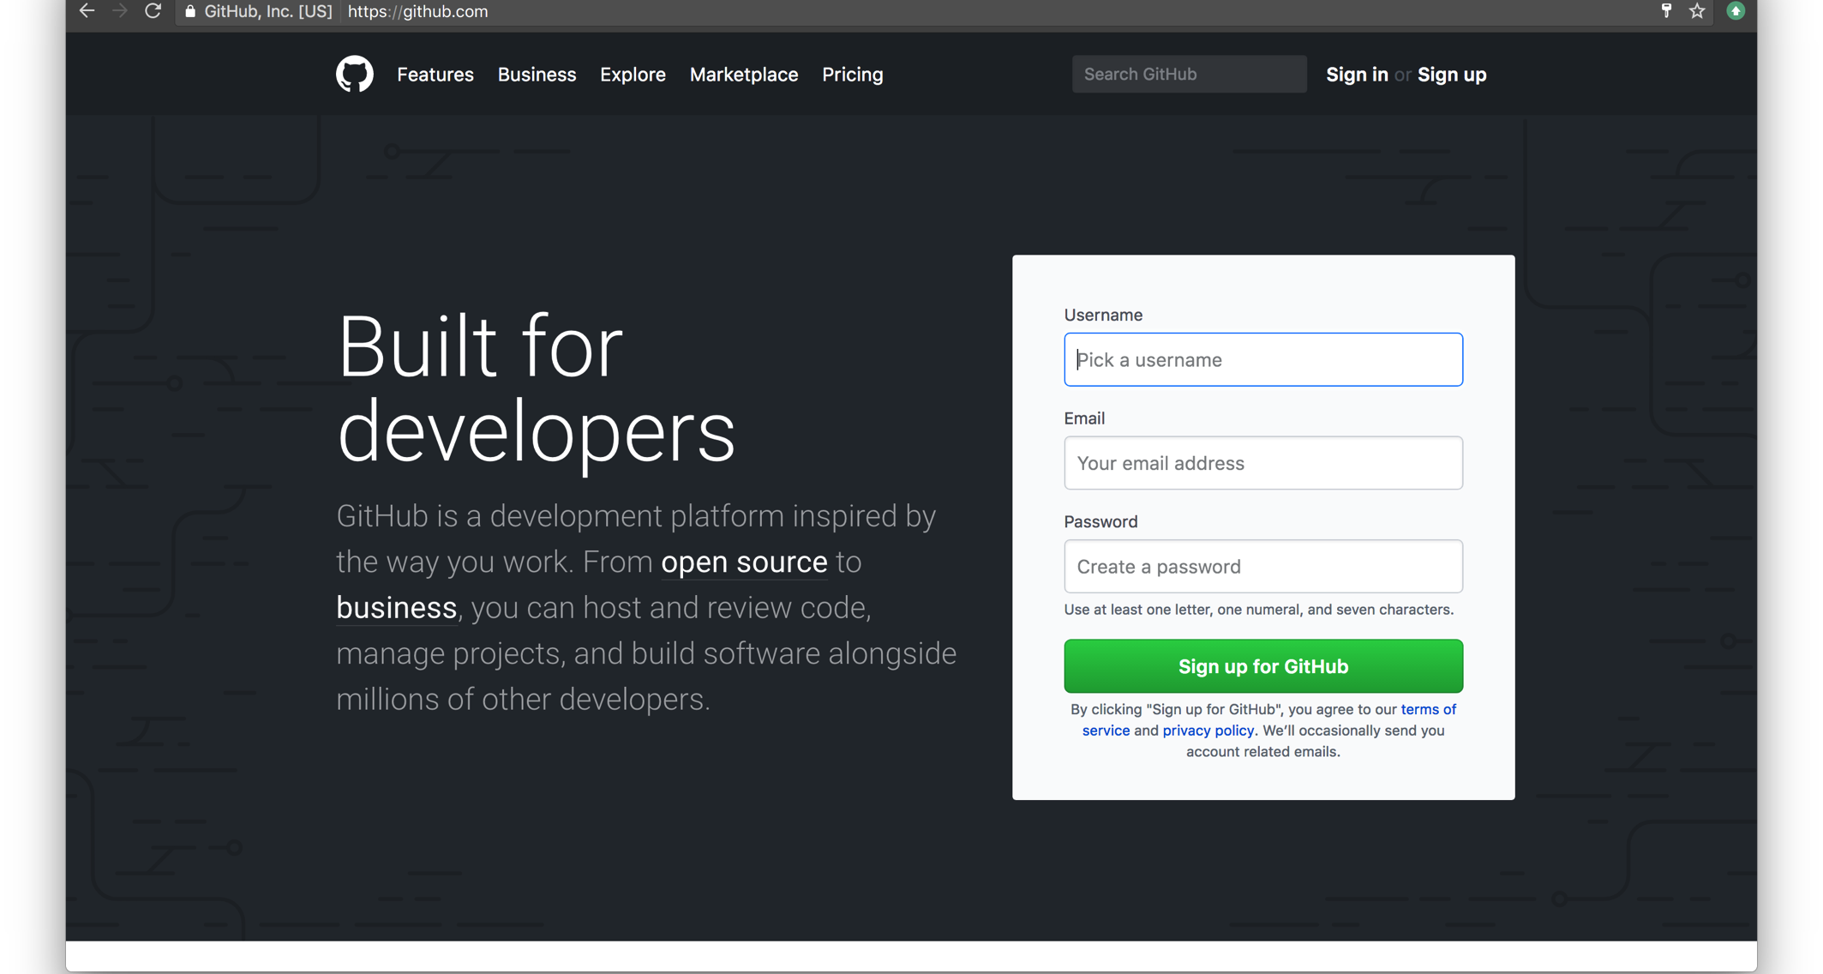
Creating an Account
Notes:
Username very important as it becomes part of your URL

Slide 9
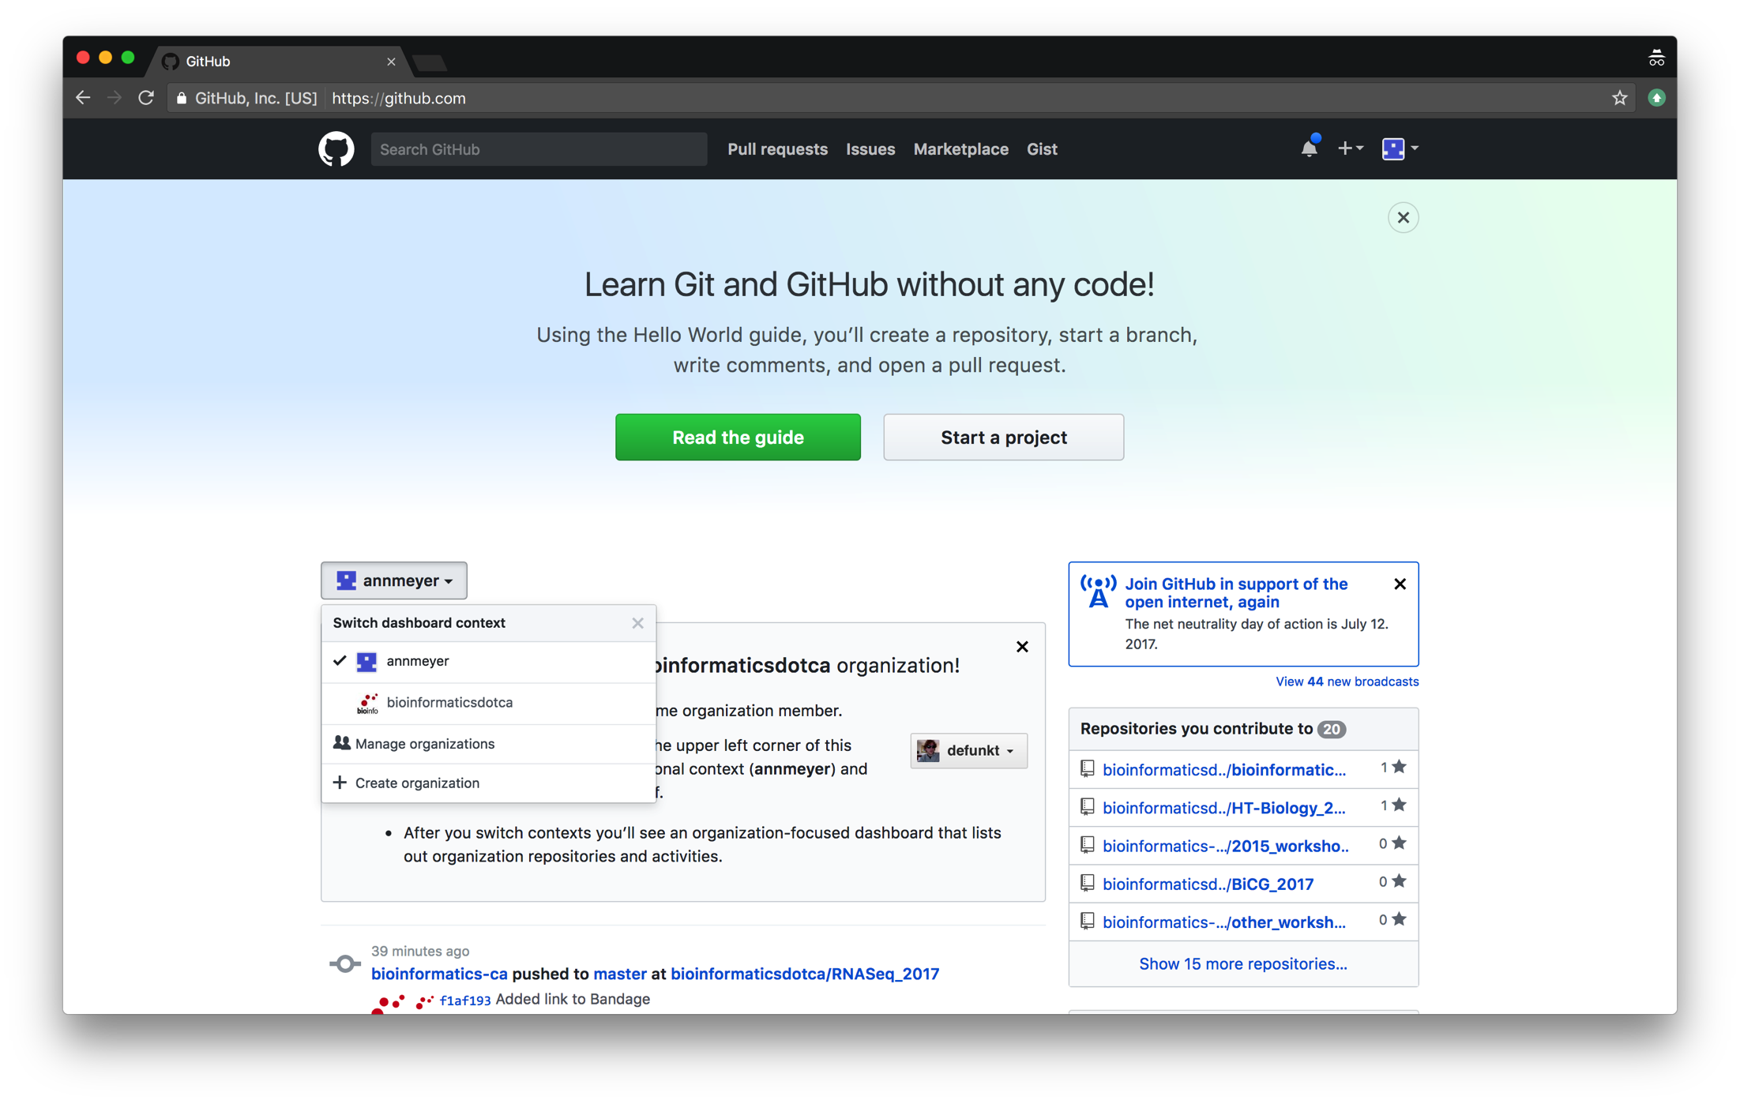
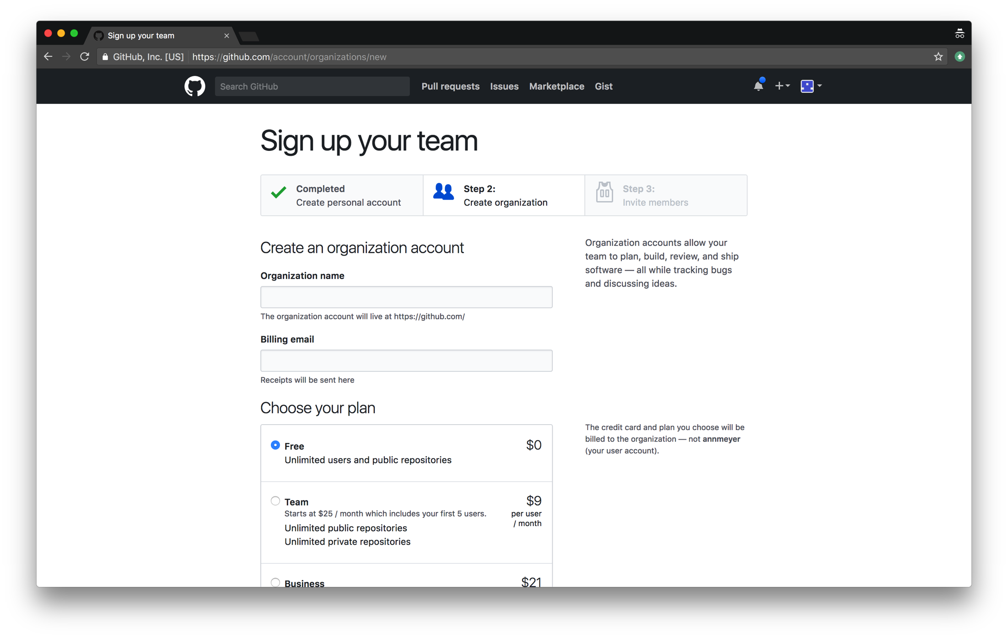
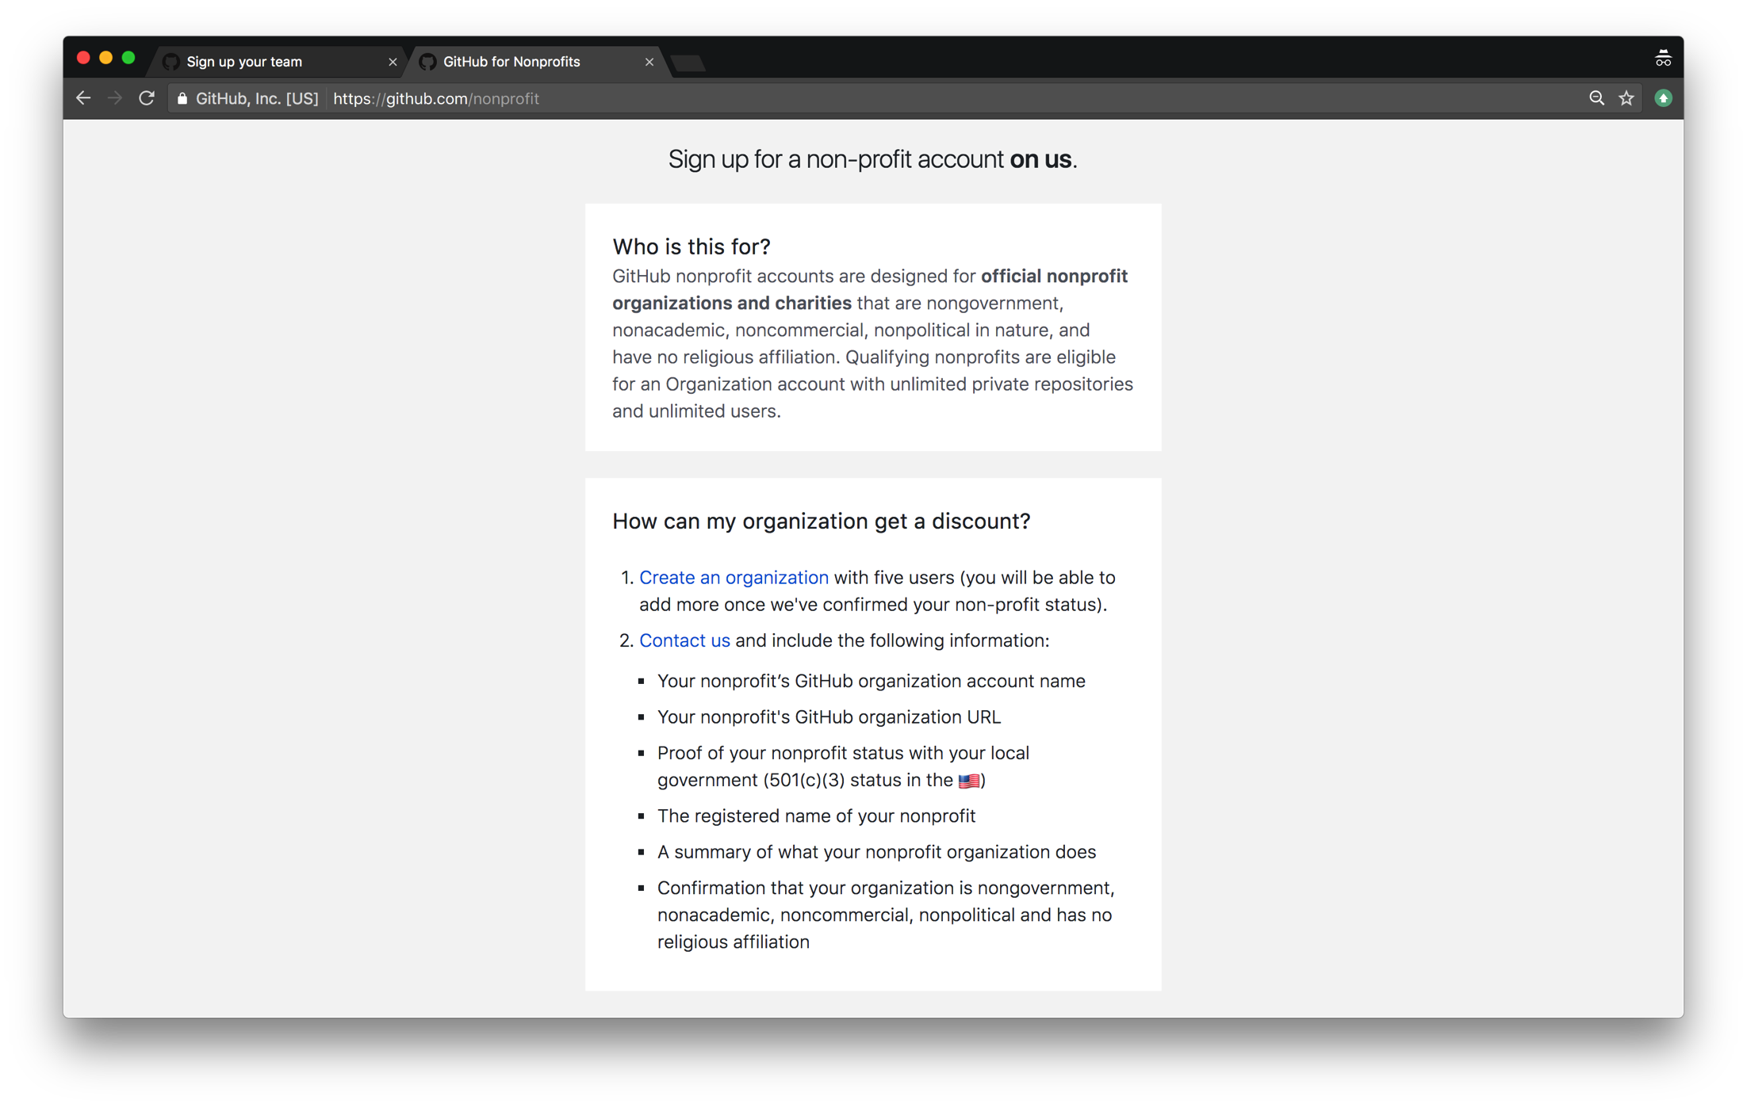
Creating an Organization

Slide 10
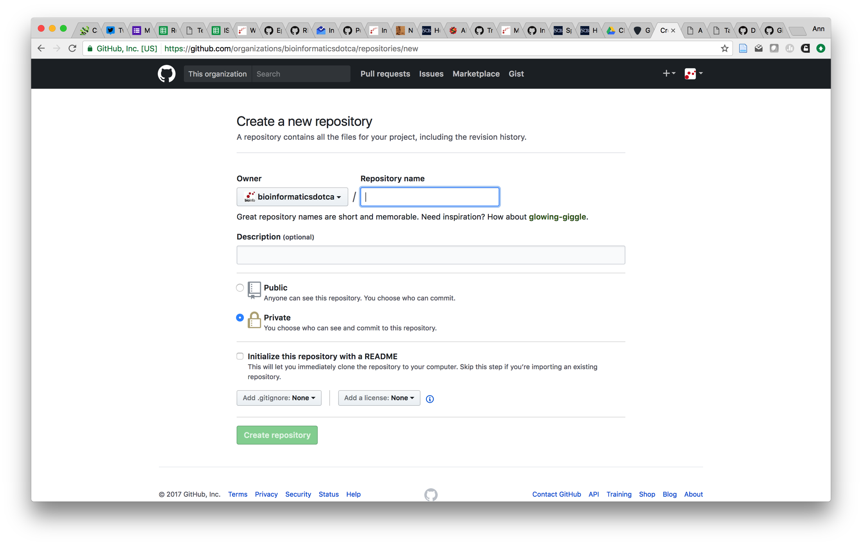
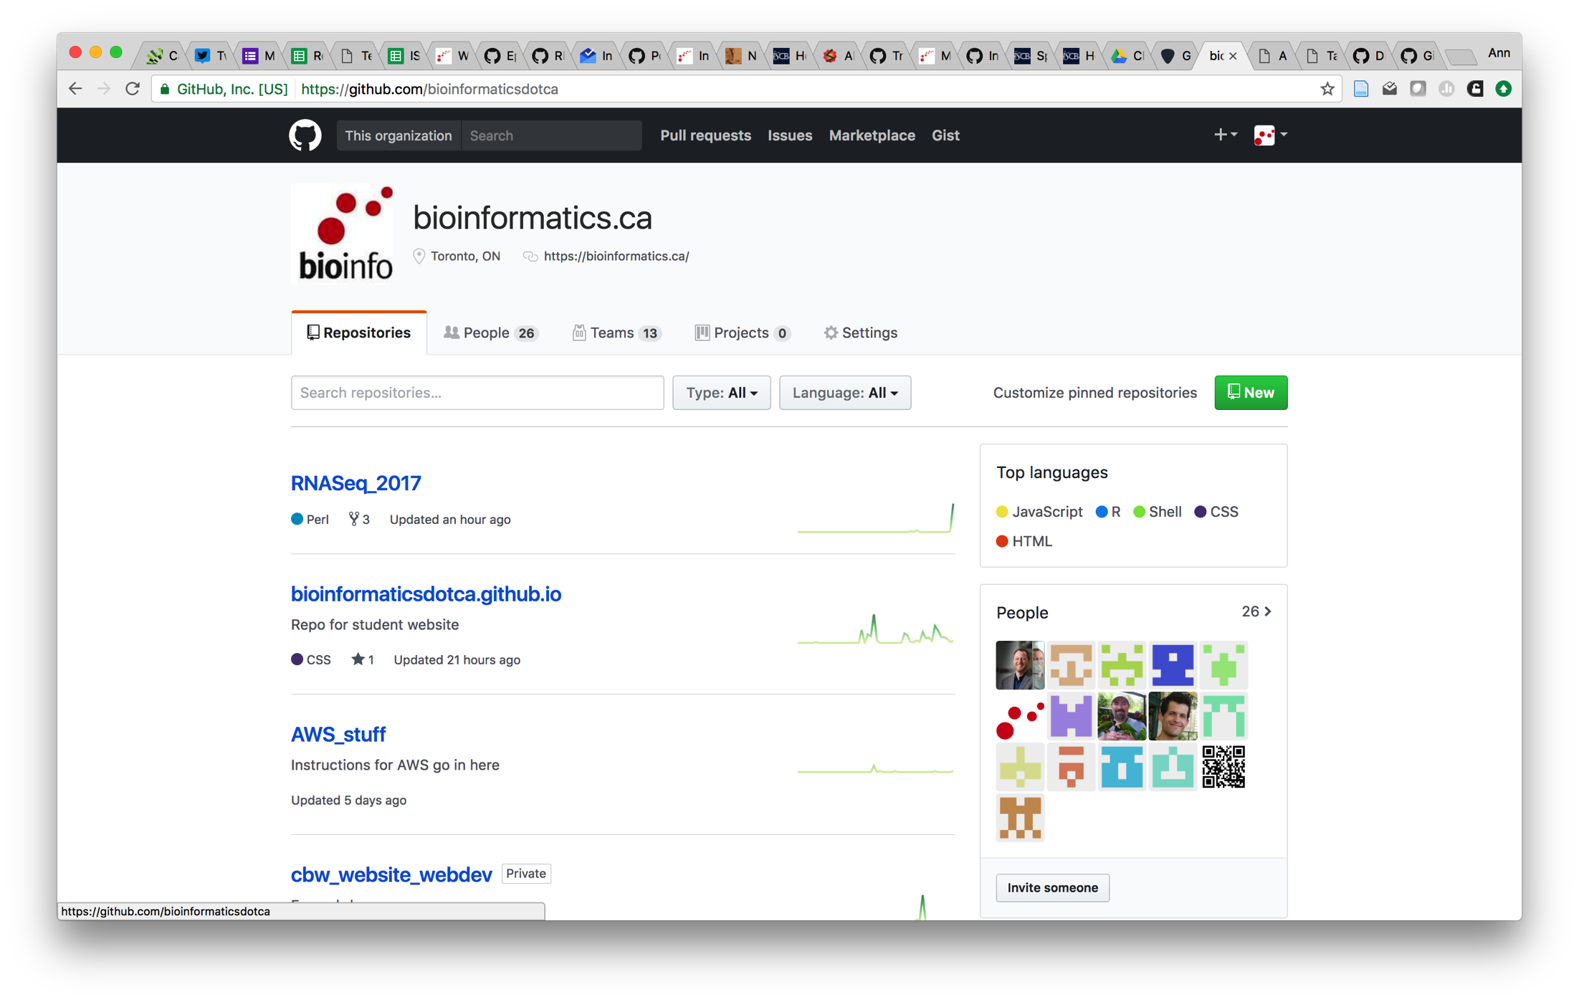
Creating Your Site Repo
Needs to be username.github.io

Slide 11

The Hard Part: Choosing a Theme
13 supported themes (https://pages.github.com/themes/)
Find a website using GitHub Pages and use their design
Create your own design
Notes:
Choose a site design – what will your site look like: Note that you will either need to know CSS or learn CSS

Slide 12

Recommended Structure
One repo for the website itself
Contains the site design files, homepage, about page
Separate repos for each workshop/course/class
Become submodules of the website repo
Able to assign teams to individual repos
Participants can pull/download content

Slide 13
A Workshop
Notes:
Might want to switch to live view here

Slide 14
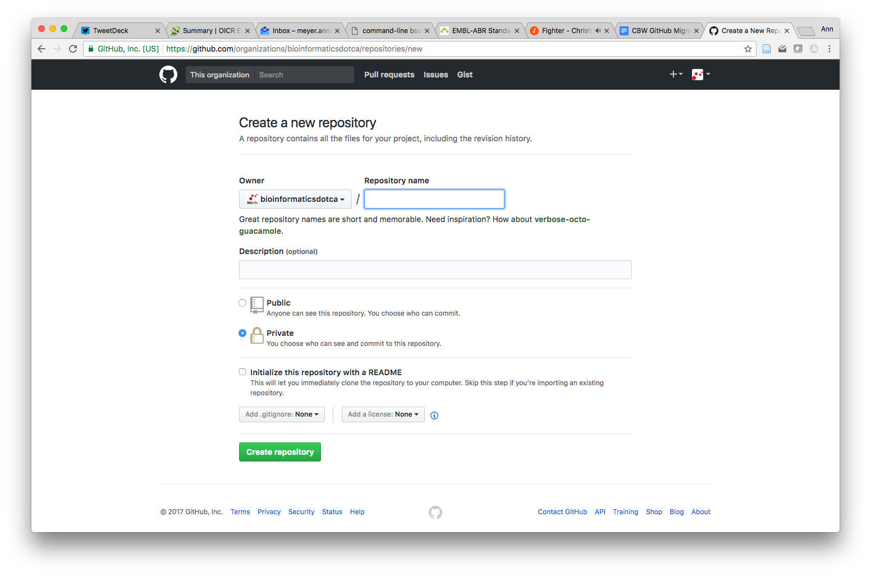
Create a New Repo
Useful to be name of workshop

Slide 15
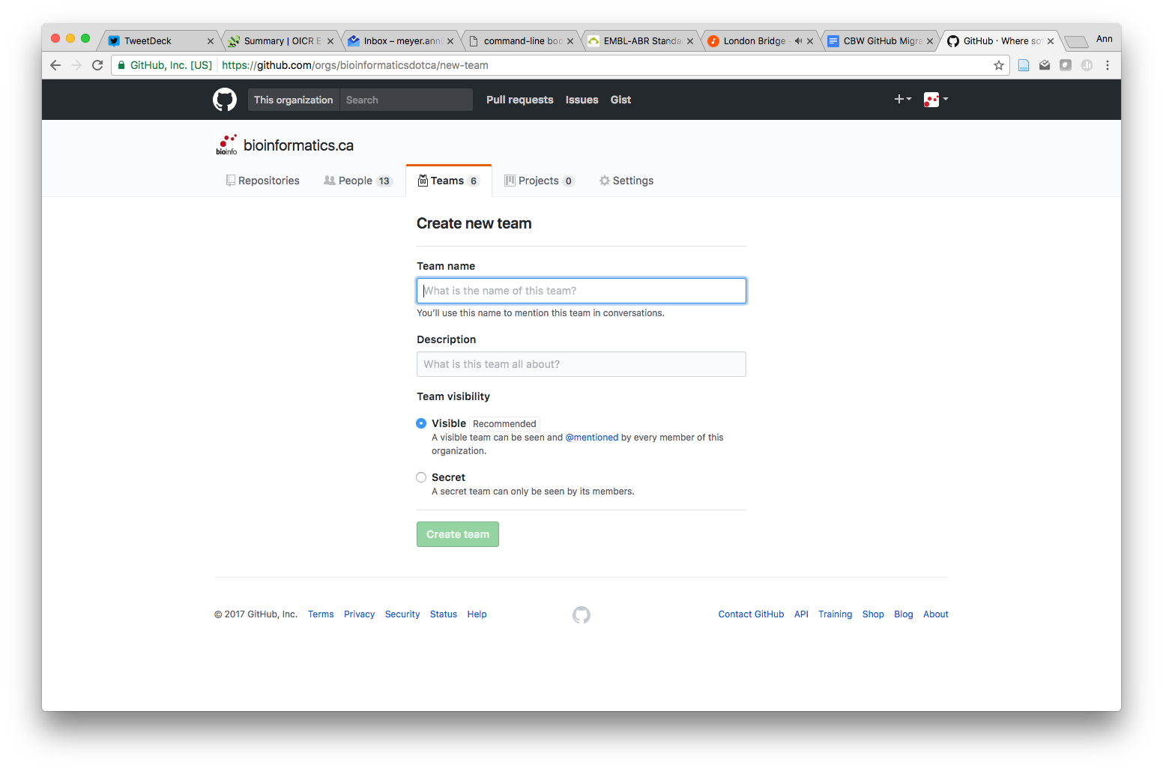
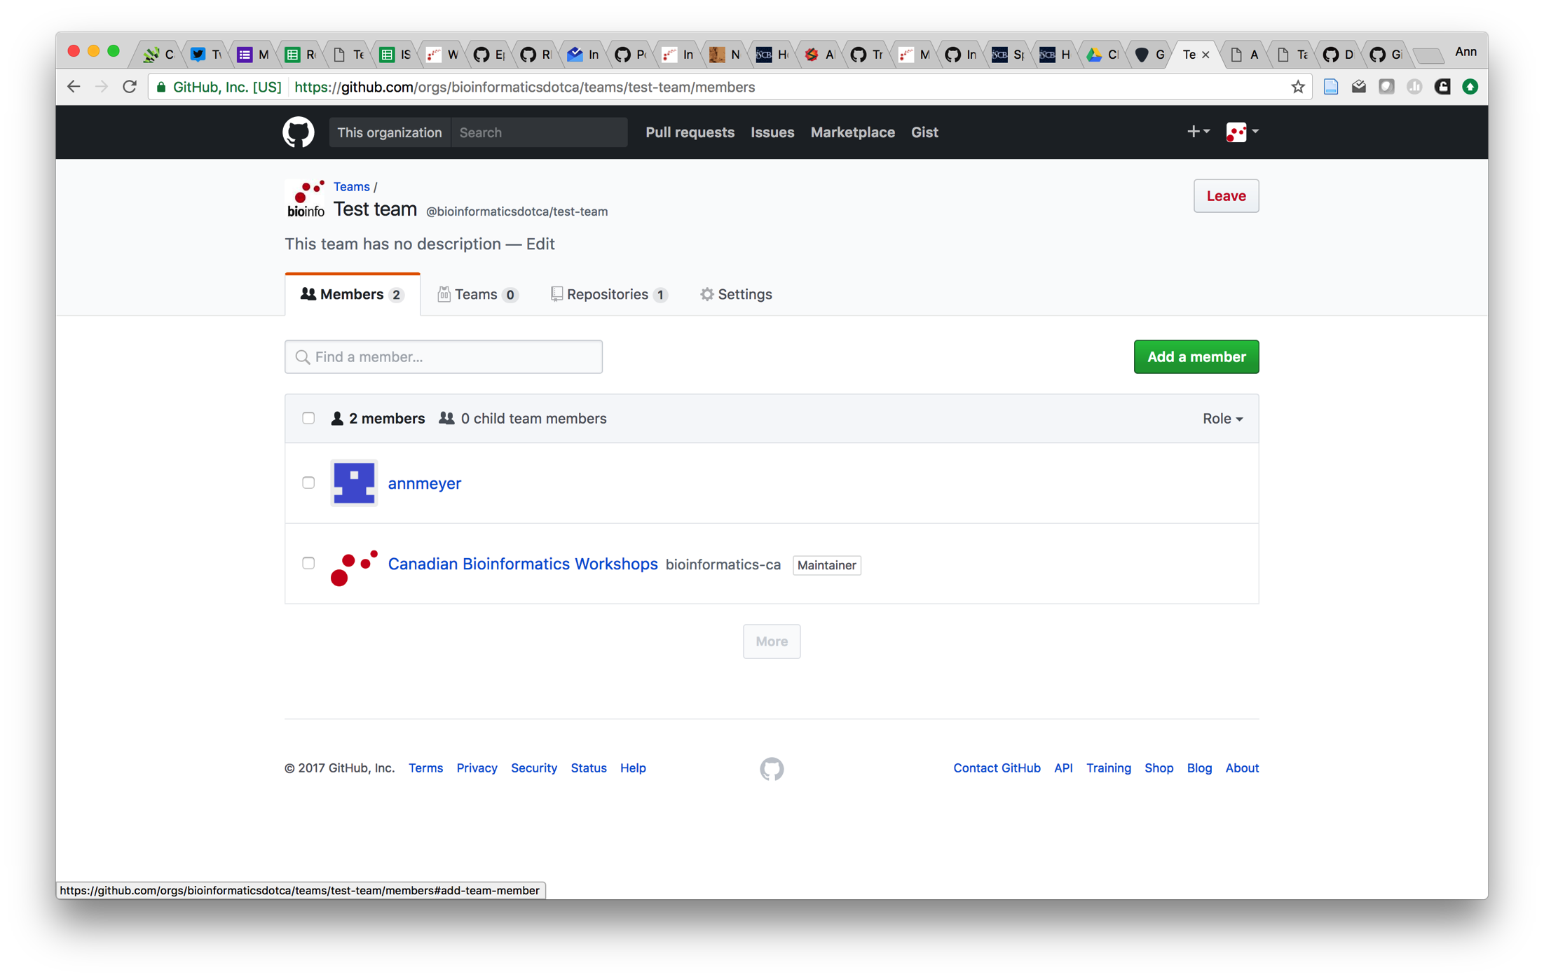
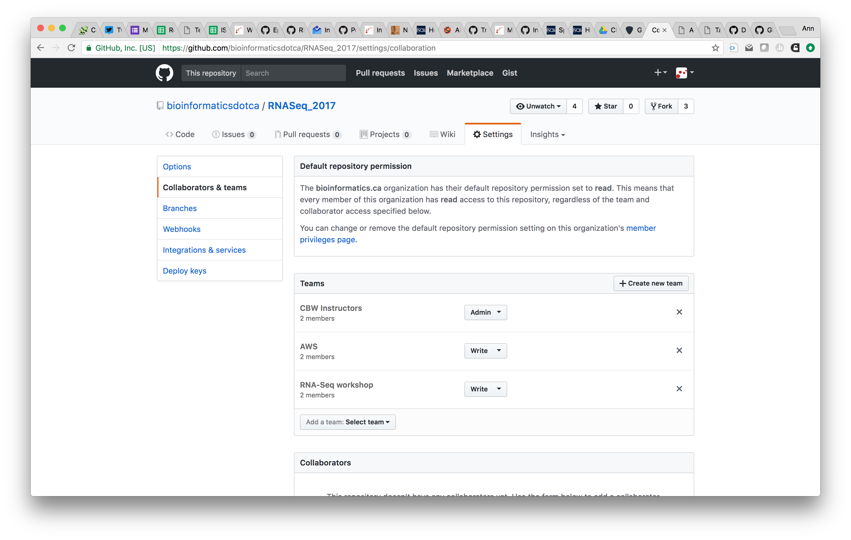
Create a Team

Slide 16
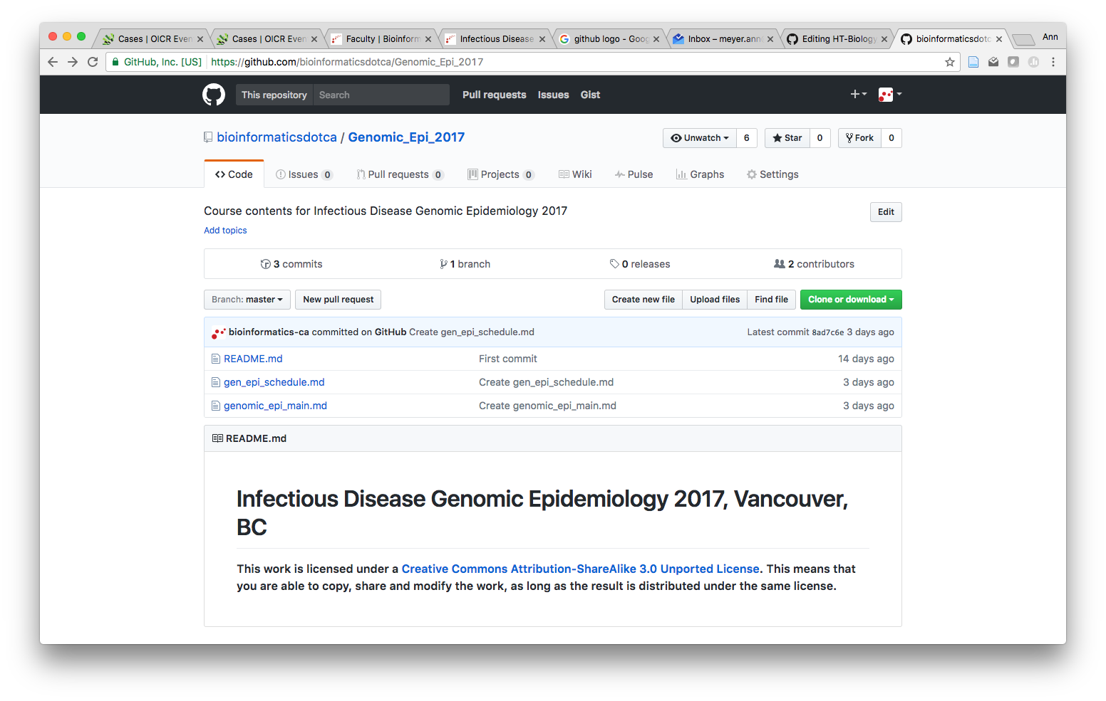
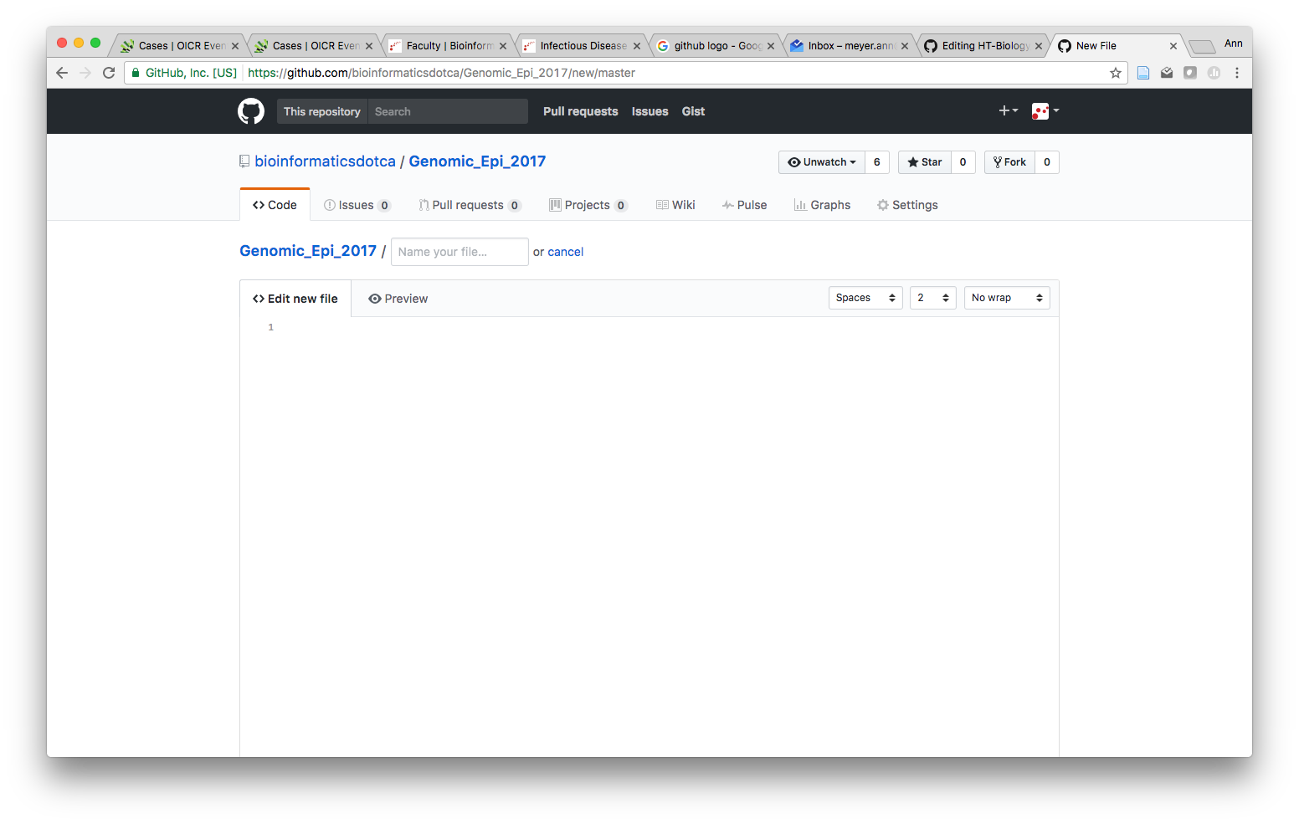
Create New Files
1. Click the “Create new file” button
2. Name your file. Use .md as the file extension.
Note: if you have supporting files for your tutorial, create a new folder for your section by typing “new folder name/new file.md”
Notes:
Consequtive basepairs

Slide 17
Page Content
The content for your page goes in the text box
Each page requires a header
Use markdown to format text

Slide 18
Header Info - Required
---
layout: tutorial_page
permalink: /high-throughput_biology_2017_module2_lab
title: HT-Biology Lab 2
header1: Workshop Pages for Students
header2: High-Throughput Biology - From Sequence to Networks Module 2 Lab
image: /site_images/CBW-CSHL-graphic-square.png
home: https://bioinformaticsdotca.github.io/high-throughput_biology_2017
---
Page layout style, use tutorial_page
Partial URL for page
Title of page (appears in website tab)
Title of tutorial
Workshop image (should be same as main workshop page)
URL for main workshop page (where you are taken when you click on home)

Slide 19
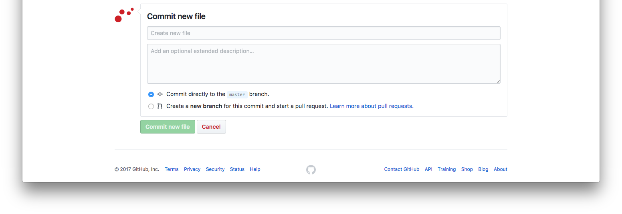
Commit Your Changes
To “save” your file, enter a commit message and “commit”

Slide 20
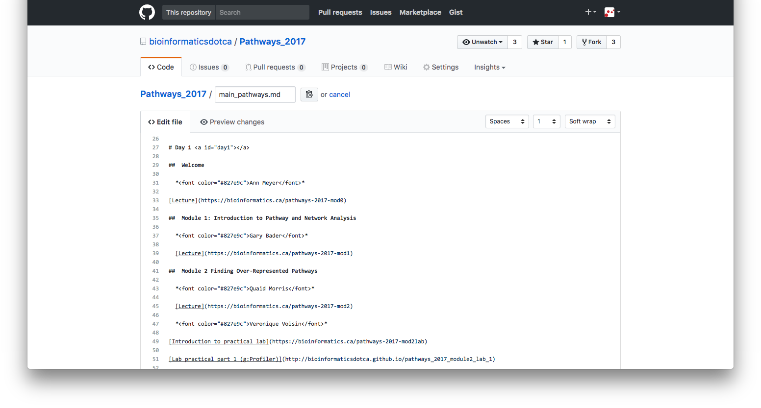
Create the Main Page
Once all the supporting pages are created, add the links to the main page
Notes:
At this point main page can be more of a place holder

Slide 21
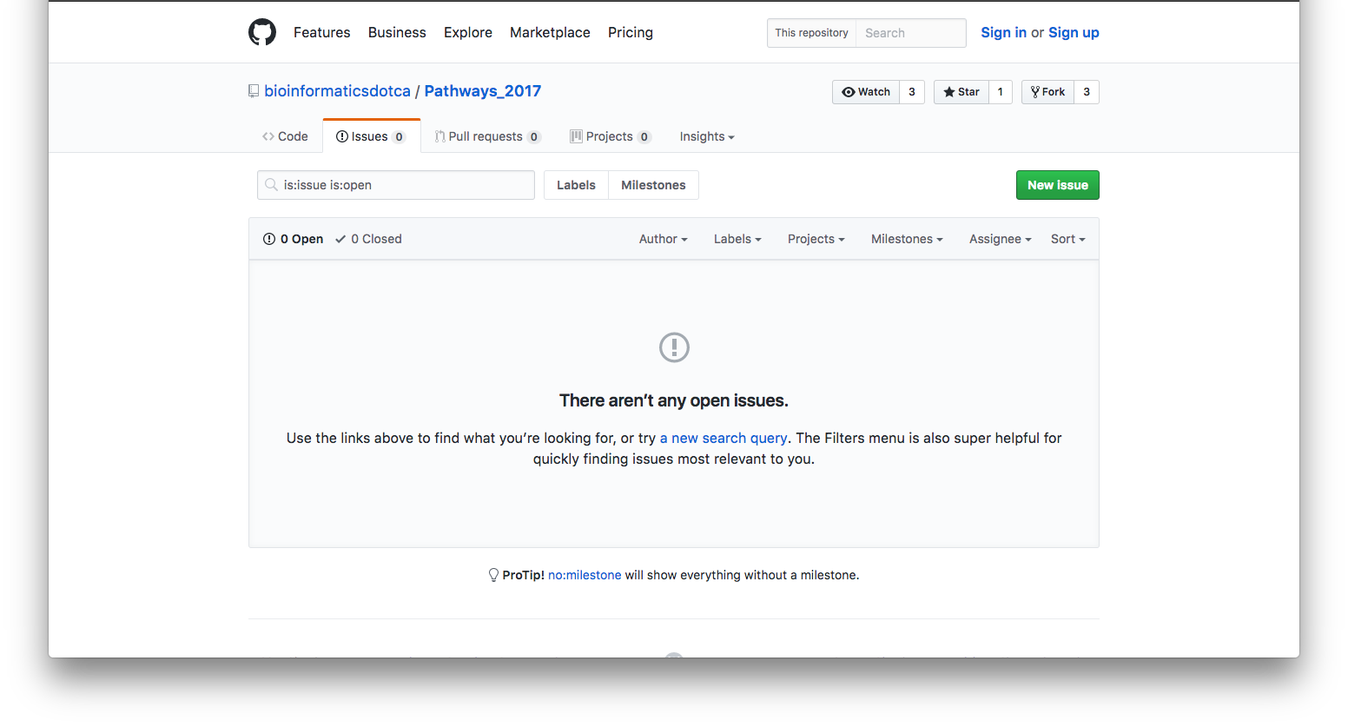
Bonus:
GitHub’s Issue tracking can be used as a Q&A system
Notes:
Only members of the team added to the repo will get notified about “issues”

Slide 22

Questions?
Poster A186
@bioinfodotca
@bioinfojobs
@meyer_ann

